Slide 1

Amritsar College of Engineering & Technology, Amritsar, Punjab, INDIA NAAC - A grade, NBA accredited courses(2009-12, 2016-18), UGC Autonomous College
SUBJECT: OOPS (ACCS-16302)
UNIT-II
Er. Neha Chadha
Assistant Professor
Department of Computer Science and Engineering

Slide 2
Passing Array to Function
void disp(int a[ ],int);
void main()
{
clrscr();
int i,a[5];
for(i=0;i<5;i++)
{
cin>>a[i];
}
disp(a,5);
}
void disp(int b[5],int size)
{
int i;
for(i=0;i<size;i++)
{
cout<<b[i];
}
}

Slide 3
Inline Function
The inline functions are a C++ enhancement feature to decrease control time of a program.
Functions can be instructed to compiler to make them inline so that compiler can replace those function definition wherever those are being called.
Inlining is only a request to the compiler, not a command. Compiler can ignore the request for inlining.

Slide 4
Compiler may not perform inlining in such circumstances like: 1) If a function contains a loop. (for, while, do-while). 2) If a function contains static variables. 3) If a function is recursive. 4) If a function return type is other than void. 5) If a function contains switch or goto statement.

Slide 5
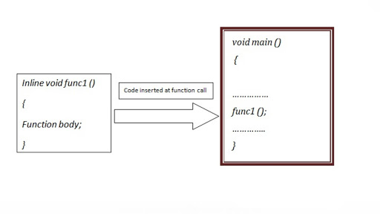
Inline Function Example
#include<iostream.h>
#include<conio.h>
inline void sum(int a,int b)
{
int c;
c=a+b;
cout<<c;
}
void main()
{
clrscr();
sum(2,3);
getch();
}

Slide 6
Macro
Macro means to define identifier with pre defined value or use substitute for identifier which will be replaced by pre defined value
Two types:
Object Macro
Function Macro

Slide 7
Object Macro Program Example -I
#include<iostream.h>
#include<conio.h>
#define value 10 //macro
void main()
{
clrscr();
int x=value-5;
cout<<x;
getch();
}

Slide 8
Function Macro Program Example -II
#include<iostream.h>
#include<conio.h>
#define sum(a,b)a+b //macro
void main()
{
clrscr();
cout<<"sum of 3 and 4is"<<sum(3,4);
getch();
}

Slide 9
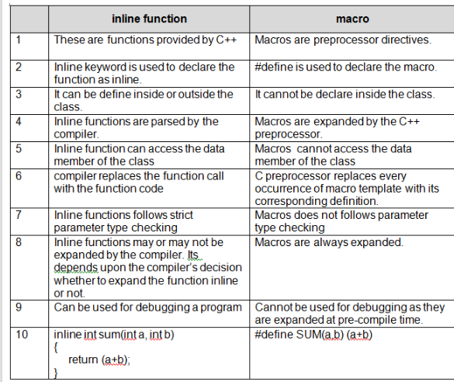

Slide 10
Default Argument(s)
A default argument is a value provided in a function declaration that is automatically assigned by the compiler if the caller of the function doesn't provide a value for the argument with a default value.

Slide 11
Default Argument Example-I
int sum(int x, int y, int z=0,int w=0)
{
return(x+y+z+w)
}
main()
{
cout<<sum(10,15)<<endl;
cout<<sum(10,15,25)<<endl;
cout<<sum(10,15,25,30)<<endl;}

Slide 12
Default Argument Example-II
int sum(int,int,int=0);
void main()
{
clrscr();
int a,b,c;
cout<<"enter two values";
cin>>a>>b;
cout<<"sum"<<sum(a,b)<<endl;
cout<<"enter three values";
cin>>a>>b>>c;
cout<<"sum"<<sum(a,b,c);
getch();
}
int sum(int x,int y,int z)
{
int w=x+y+z;
return w;
}

Slide 13
Function overloading
Function overloading is a C++ Programming feature that allows us to have more than one function having same name but different parameter list.
myfunc(int a, float b)
myfuncn(int a, int b, int c)
Function overloading is a compile-time polymorphism.

Slide 14
Function overloading Example
void sum(int a,int b)
{
int c;
c=a+b;
cout<<c;
}
void sum(int a,int b,int c)
{
int d;
d=a+b+c;
cout<<d;
}
void main()
{
clrscr();
sum(2,3,4);
sum(2,3);
getch();
}

Slide 15
Structure
Structure is a collection of variables of different data types under a single name. It is similar to a class in that, both holds a collection of data of different data types.

Slide 16
Syntax of Structure
Syntax
struct [structure tag]
{
member definition;
member definition;
...
member definition;
} [one or more structure variables];
Example:
struct student
{
int rollnumber;
char name[20];
}s;

Slide 17
Structure Example
#include<iostream.h>
#include<conio.h>
struct stu
{
int rn;
};
void main()
{
clrscr();
struct stu s1;
s1.rn=101;
cout<<s1.rn;
getch();
}

Slide 18
Self Referential Structure
Self referential structure is a structure which help one or more link(pointer) which point itself.
Syntax:
struct structname
{
struct structname *pointername;
};

Slide 19
Self referential structure Example
struct stu
{
int rn;
struct stu *link; //self referential structure
};
void main()
{
clrscr();
struct stu s1;
struct stu s2;
s1.link=NULL; //initial s1 link is null
s1.rn=1;
s2.link=NULL; //initial s2 link is null
s2.rn=2;
//in above two different nodes have been created
s1.link=&s2;
cout<<"roll no of s2"<<s1.link->rn; //s1 link access rn of s2 coz contain addrs of s2
getch();}

